Slide 1
CSTAT Workshop SAS AND R AND SAS
Barry DeCicco, CSTAT (decicco1@msu.edu)
Center for Statistical Training and Consulting(cstatinf@msu.edu)
August 2021

Slide 2
What is CSTAT?
CSTAT is the Center for Statistical Training and Consulting, https://cstat.msu.edu/
CSTAT provides collaboration, statistical training and support for MSU people.
CSTAT support is paid for by sponsoring units at MSU, by grants or through direct payment.
Notes:
CSTA provides support in study design, sampling design, sampling plans, analysis (planning and conduct), data management planning and services, and assistance on report/publication writing.

Slide 3
What this Presentation will Cover
Calling R from SAS.
Calling SAS from R.
References.

Slide 4
CALLING R FROM SAS USING SAS/IML

Slide 5
WHY USE R IF YOU HAVE SAS?
You can use SAS for what you already know well, and use R only as needed.
You might find that you don’t have the capacities in SAS which you desire.
R has vast and rapidly growing capacities – over 10,000 packages.

Slide 6
What this Presentation will Cover
Calling R from SAS.
Calling SAS from R.
References.

Slide 7
BASICS OF R
R must be installed on your computer. Download from CRAN: https://cran.r-project.org
Necessary packages (modules) must be downloaded from CRAN and installed: (select ‘Packages’ from the left-hand menu).
You will need to set up SAS to use R.

Slide 8
SETTING UP SAS TO USE R
You need to edit the file ‘SASv9.cfg’, which controls some configurations (run ‘proc options option=config;’ to find it).
Make a copy, and then edit the original, adding these lines:
-RLANG
-config "C:\Program Files\SASHome\SASFoundation\9.4\nls\en\sasv9.cfg“[replace with folder name for where this file is on your computer]
-SET R_HOME "C:\Program Files\R\R-4.0.5 “ [replace with folder name for where R lives on your computer]

Slide 9
A NOTE ON MS OneDrive
I have found that OneDrive causes all sorts of problems with many applications.
For example, I run python from my C:\drive, not from OneDrive.
If you can’t get things to work, and you’ve reviewed them, trying moving things like R files to the C\: drive, and working from there.

Slide 10
HOW TO SUBMIT R CODE IN SAS
When running analyses/data manipulations in R, there are things which need to be done:
Setting directories as needed, to pull/save data, output and graph files.
Loading (already installed!) necessary packages for use (e.g., ‘ggplot2’ for complex graphs).e will need to be done in the SAS code
submitted to R each time. Think ‘batch file’.

Slide 11
STARTING LINES for SAS
Use PROC Options to enable SAS to use R:
proc options option=rlang; run;
Start IML (this has to be done through SAS/IML):
Proc IML;
Export SAS datasets to R as needed:
Call ExportDataSetToR(SAS-data-set, RDataFrame);
Let SAS know to start R:
submit / R;
Run R commands

Slide 12
ENDING LINES for SAS
Retrieve data sets from R as needed:
CALL IMPORTDATASETFROMR (SAS-data-set, RExpr) ;
Let SAS know to end sending commands to R:
endsubmit;
Quit IML (if no further IML use is needed):
quit;

Slide 13
R LANGUAGE COMMANDS
Set the working directory (location where R retrieves and stores files), while storing the previous location in ‘old_wd’:
old_wd<-setwd("C:/Users/Barry/Desktop")
Resetting the working directory back to what it was:
setwd(old_wd);
# this is how comments are done in R

Slide 14
GOING THROUGH THE LOG - PRELIMINARIES
/* Start R options/ */
proc options option=rlang;
run;
libname a ‘C:\Users\decicco1\OneDrive - Michigan State University\CSTATRedirects\Documents\R Studio Projects\SASandRandSAS\data';
run;

Slide 15
GOING THROUGH THE LOG - PRELIMINARIES
proc iml;
title "Statistic in R (integration with SAS)";
run;
ExportDataSetToR(“a.RCBD_TEST", "RCBD_IN_R");
submit / R;

Slide 16
GOING THROUGH THE LOG – SUBMITTING COMMANDS TO R
#_______Beginning of R code_________
# Change the working directory, saving the old one in ‘old_wd’:
old_wd<-setwd("C:/Users/Barry/Desktop")

Slide 17
GOING THROUGH THE LOG – SUBMITTING COMMANDS TO R
# Load the ‘qicharts’ module (package), so that it can be used.
library(qicharts)

Slide 18
GOING THROUGH THE LOG – SUBMITTING COMMANDS TO R
# Create a data frame (data set)
d2 <- data.frame(y = rnorm(144, 12, 3),
expand.grid(x = seq.Date(as.Date('2014-1-1'),
by = 'week',
length.out = 24),
g1 = LETTERS[1:3],
g2 = letters[1:2]))

Slide 19
GOING THROUGH THE LOG – SUBMITTING COMMANDS TO R
# Introduce a shift in process performance
d2$y[132:144] <- d2$y[132:144] * 3

Slide 20
GOING THROUGH THE LOG – SUBMITTING COMMANDS TO R
# Run a chart.
trc(y ~ x | g1 + g2, data = d2, main = 'Trellis run chart', chart = 'i')

Slide 21
GOING THROUGH THE LOG – SUBMITTING COMMANDS TO R
# Direct the graphics output to a file, then close it (until it’s closed, you can’t access the file).
dev.copy(pdf,'myplot.pdf',width=6,height=4 )
dev.off()

Slide 22
GOING THROUGH THE LOG – SUBMITTING COMMANDS TO R
# Reset the working directory, which was stored in ‘old_wd’:
# Reset the working directory
setwd(old_wd)

Slide 23
GOING THROUGH THE LOG – WRAPPING UP
# End of R code
endsubmit; # Any error messages from R will now show up

Slide 24
GOING THROUGH THE LOG – WRAPPING UP
# Any error messages from R will now show up
* Bring the data set from R to SAS;
CALL IMPORTDATASETFROMR ("work.d2", "d2") ;
* Print the data set;
proc print data=d2;
run;

Slide 25
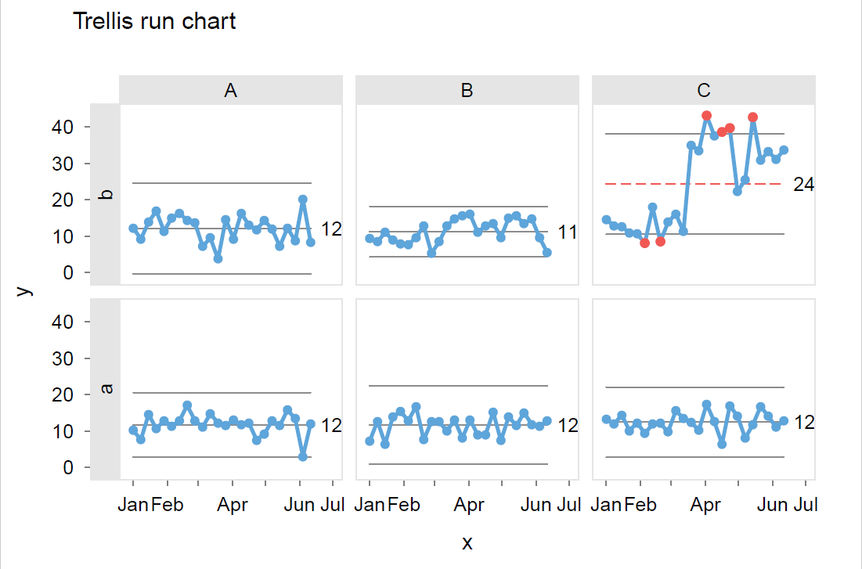
RESULT – FIX ME
l

Slide 26
CALLING SAS FROM R USING KNITR AND MARKDOWN

Slide 27
WHAT IS KNITR?
knitr is an R package which combines code, comments, text and results into one document.
You write a document with text and code chunks.
knitr will run the code chunks and incorporate the results, knitting them into a single document.
This document can be in Word, HTML or PDF (the latter requires outside software).

Slide 28
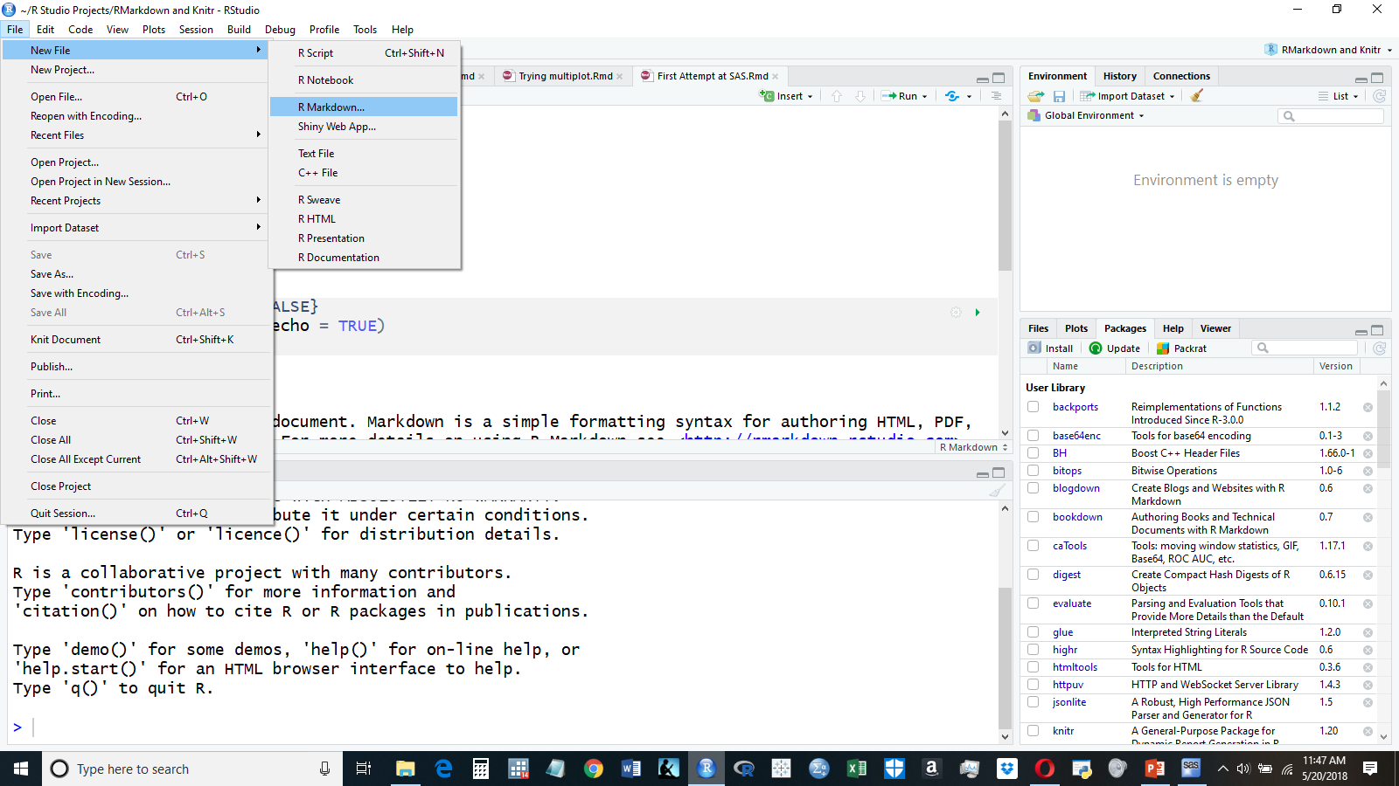
STARTING OFF – IN RSTUDIO

Slide 29
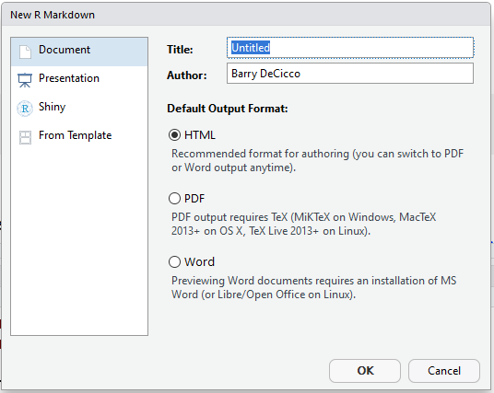
THREE OUTPUT OPTIONS
HTML – easiest to start with.
Word.
PDF – this requires external software to finish.
I will use HTML

Slide 30
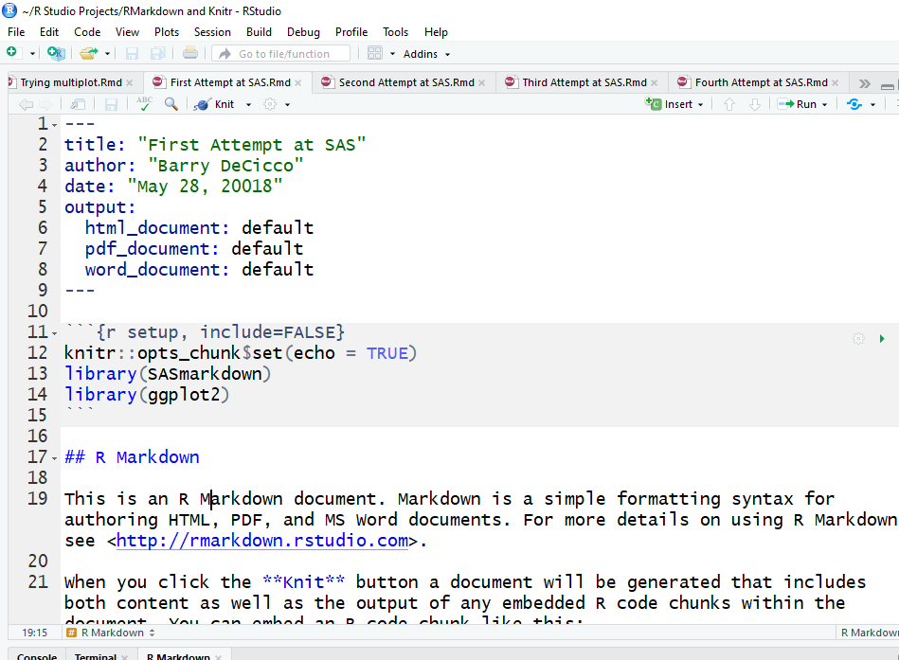
STARTING THROUGH THE DOCUMENT
Knitr will set up a standard starting document prepopulated with some items.
Title information.
Initial setup.
Explanation

Slide 31
LIMITATIONS
Each code chunk runs a separate batch job in SAS. There is no hand-off of WORK. data sets between SAS code chunks. (‘work’ is a temp folder for SAS)
To hand off data sets (between SAS and SAS, or SAS and R), save them as permanent files.
SAS HTML output plays well with knitr’s HTML markdown. For other types of output, other packages are needed.
Slashes/back-slashes in path names need to be managed.

Slide 32
SET UP
Let R know that it’s using sas (the ‘SAS’ or ‘SASHTML’ engine).
Tell R where the SAS.exe file is.
Set any SAS options.
These can by done either by chunk, or overall (for now, overall).

Slide 33
SET UP
There are at least 20 ‘engines’ available for knitr, meaning 20 languages.
For SAS, there is the ‘sas’ and ‘sashtml’ engines.
For this presentation, the ‘sashtml’ engine will be used. SAS will give output in HTML.

Slide 34
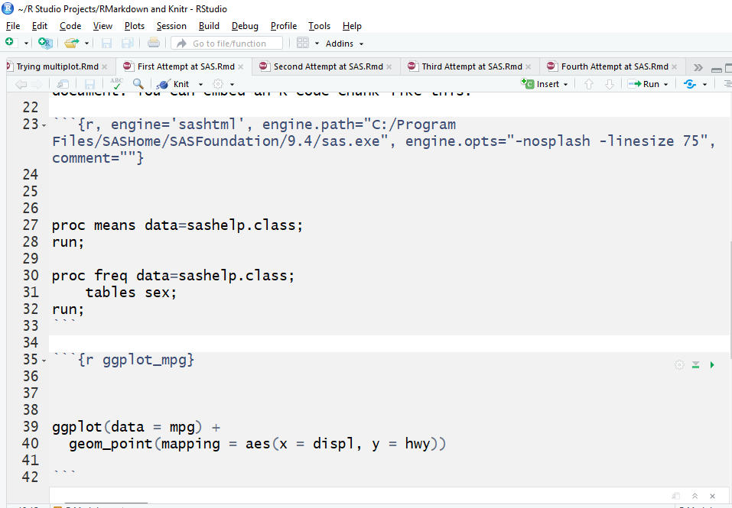
SETTING UP SAS IN A CODE CHUNK
Gray items are ‘code chunks’, where there is code to be executed.
They start and end with ```
This sets up SAS in this code chunk. It tells R to use SAS, and where SAS is.
This applies *only* to this chunk.

Slide 35
SETTING UP SAS IN A CODE CHUNK
Gray items are ‘code chunks’, where there is code to be executed.
They start and end with ```
This sets up SAS in this code chunk. It tells R to use SAS, and where SAS is.
This applies *only* to this chunk.

Slide 36
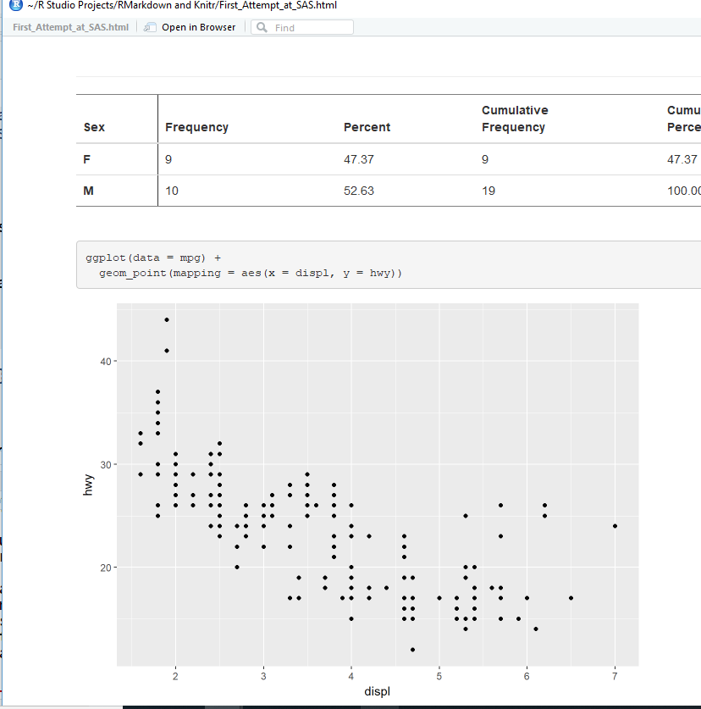
RUNNING SAS
Once the set up has been done SAS commands can be done in one chunk, with r commands in another.

Slide 37
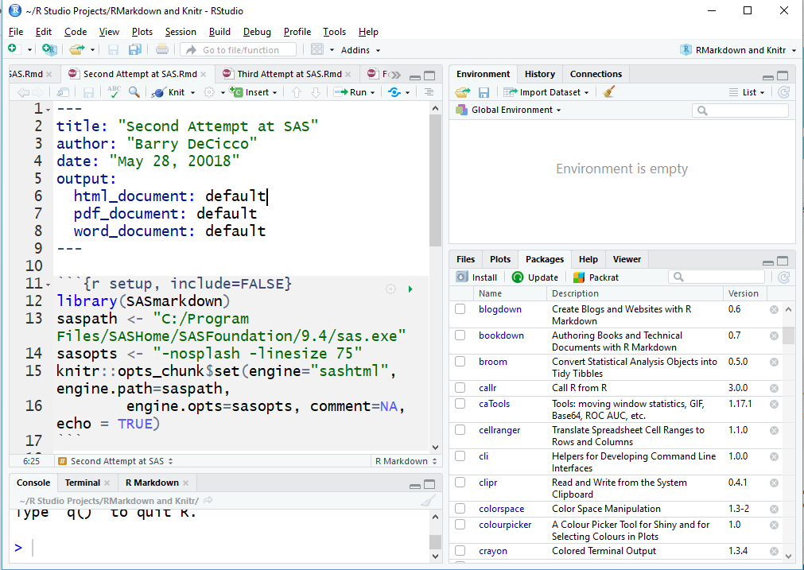
IMPORTANT NOTE ON THE SETUP CHUNK
Setting the SAS option in the setup code chunk will cause knitr means to run *all* code chunks in the document with SAS.

Slide 38
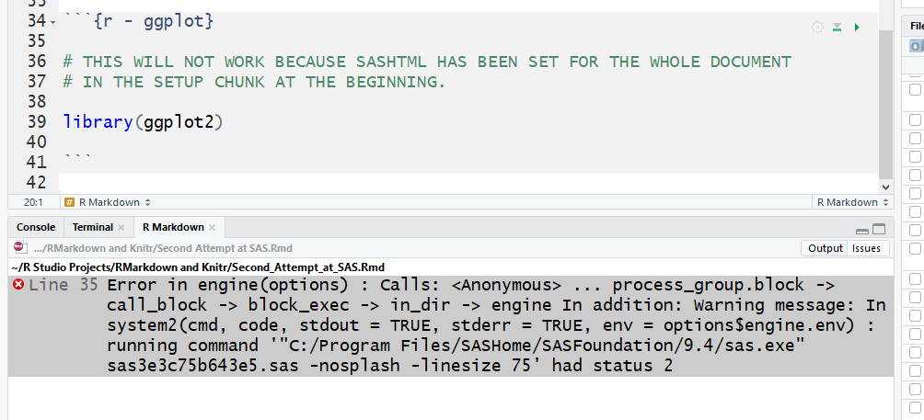
IMPORTANT NOTE ON THE SETUP CHUNK
Setting the SAS option in the setup code chunk will cause knitr means to run *all* code chunks in the document with SAS.

Slide 39
Questions?

Slide 40
Appendices
Appendix A: SAS Documentation
Appendix B: R Documentation
Appendix C: How to get a copy

Slide 41
Appendix A: SAS Documentation
SAS/IML(R) 9.3 User's Guide ‘The RLANG System Option’ http://support.sas.com/documentation/cdl/en/imlug/64248/HTML/default/viewer.htm#imlug_r_sect003.htm
SAS/IML(R) 9.3 User's Guide‘Submit R Statements’ http://support.sas.com/documentation/cdl/en/imlug/64248/HTML/default/viewer.htm#imlug_r_sect004.htm

Slide 42
Appendix A (con):
SAS/IML(R) 12.1 User's Guide: EXPORTDATASETTOR Call http://support.sas.com/documentation/cdl/en/imlug/65547/HTML/default/viewer.htm#imlug_langref_sect114.htm
SAS/IML(R) 12.1 User's Guide: IMPORTDATASETFROMR Call http://support.sas.com/documentation/cdl/en/imlug/65547/HTML/default/viewer.htm#imlug_langref_sect182.htm

Slide 43
Appendix A (con):
‘Run R code inside SAS easily’ SAS/IML(R) 9.3 User's Guide ‘EXPORTDATASETTOR Call’ http://support.sas.com/documentation/cdl/en/imlug/65547/HTML/default/viewer.htm#imlug_langref_sect114.htm
SAS Blogs: Video: Calling R from the SAS/IML Language https://blogs.sas.com/content/iml/2011/10/31/video-calling-r-from-the-sasiml-language.html

Slide 44
Appendix B: R Documentation
‘SAS Using R Markdown (Windows)’ https://www.ssc.wisc.edu/~hemken/SASworkshops/Markdown/SASmarkdown.html#html-or-pdf-document-as-a-final-target
The raw markdown version of the above page: https://www.ssc.wisc.edu/~hemken/SASworkshops/Markdown/SASmarkdown.rmd
‘Tables and Graphs - Using the sashtml Engine’ https://www.ssc.wisc.edu/~hemken/SASworkshops/Markdown/SAShtmlengine.html
Dynamic Documents with R and Knitr (by Yihui Xie) https://yihui.name/knitr/

Slide 45
Appendix C: How to get a copy
This presentation is stored on GitHub: https://github.com/BarryDeCicco/SASandRandSAS
It is currently private but should be set to public very soon.

